Slide 1
Movie Recommender System -Project
Big data analytics track Project – Submitted by Shalini gupta

Slide 2
Profile Details
Name: Shalini Gupta
Email ID: shalini2501@gmail.com
Course Enrolled: Big Data Analytics
Project Name: Movie Recommender System

Slide 3
Project Details
Domain: Entertainment
Topic: Movie Recommender System
Technology used: Hadoop, Spark Core, Spark SQL, Spark MLLib, Scala

Slide 4
Project Introduction
The project is based on film industry data that has been collected by Group Lens Research. We are provided with the datasets with movies rating, users who rated movies. In the project, we have analysed the data sets to find the solutions of asked queries and created a movie recommendation system based on personal rating.
Dataset: users.dat, movies.dat, and ratings.dat

Slide 5
Dataset Description
Meta Data of movies.dat:
MovieID::Title::Genres
Titles are identical to titles provided by the IMDB (includingyear of release)
Genres are pipe-separated and are selected from the following genres:
Action, Adventure, Animation, Children’s, Comedy, Crime, Documentary, Drama, Fantasy, Film-Noir, Horror, Musical, Mystery, Romance, Sci-Fi, Thriller, War, Western
Meta Data of users.dat:
UserID::Gender::Age::Occupation::Zip-code
Gender is denoted by a "M" for male and "F" for female
Age is chosen from the following ranges:
1: "Under 18“ , 18: "18-24“, 25: "25-34“, 35: "35-44“, 45: "45-49“, 50: "50-55“, 56: "56+“
Meta Data of ratings.dat:
UserID::MovieID::Rating::Timestamp
UserIDs range between 1 and 6040
MovieIDs range between 1 and 3952
Ratings are made on a 5-star scale (whole-star ratings only)
Timestamp is represented in seconds since the epoch as returned by time(2)
Each user has at least 20 ratings

Slide 6
Code to create Data Rdds:
For movies.dat:
For ratings.dat:
For users.dat:
val moviesRDD = sc.textFile("movies.dat")
val ratingsRDD = sc.textFile("ratings.dat")
val usersRDD = sc.textFile("users.dat")

Slide 7
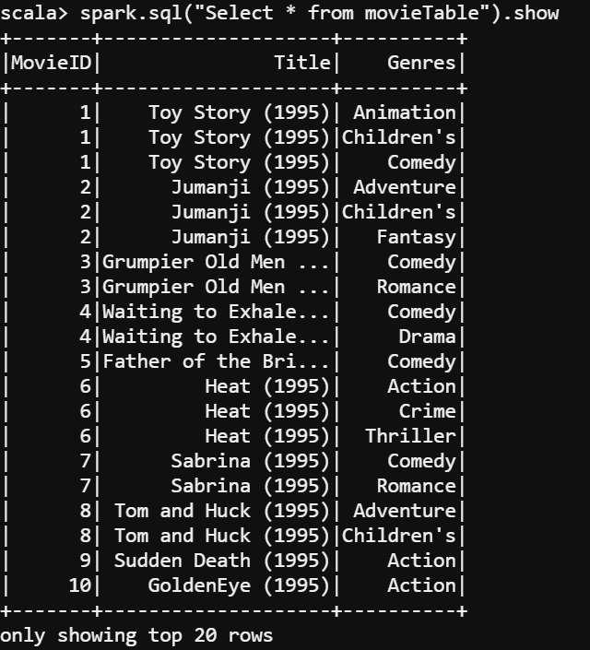
Code for Case Classes, basic DF and Table:
For movies.dat:
case class moviesClass(MovieID:Int,Title:String,Genres:String)
val md = moviesRDD.map(x=>((x.split("::")(0).toInt,
x.split("::")(1).trim),
x.split("::")(2).trim))
val data = md.flatMapValues(x=>x.split('|’))
val movieVar=data.map(x=>moviesClass(x._1._1,x._1._2,x._2)).toDF()
movieVar.createOrReplaceTempView("movieTable")

Slide 8
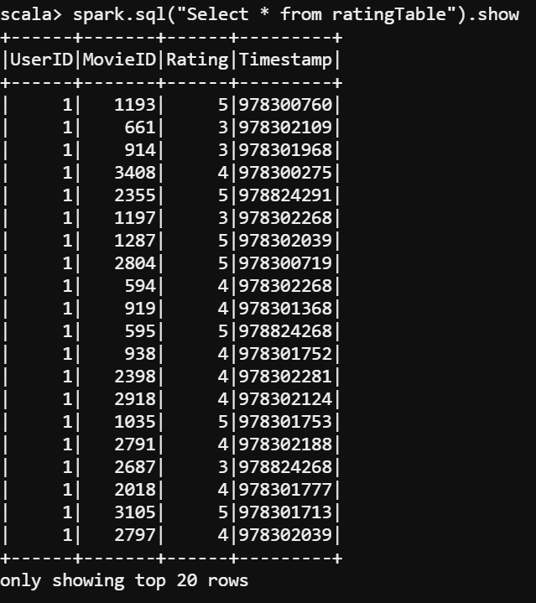
For ratings.dat:
case class ratingClass(UserID:Int, MovieID:Int, Rating:Int, Timestamp:Long)
val ratingVar = ratingsRDD.map(_.split("::"))
.map(row=>ratingClass(row(0).trim.toInt,
row(1).trim.toInt,
row(2).trim.toInt,
row(3).trim.toLong)).toDF()
ratingVar.createOrReplaceTempView("ratingTable")

Slide 9
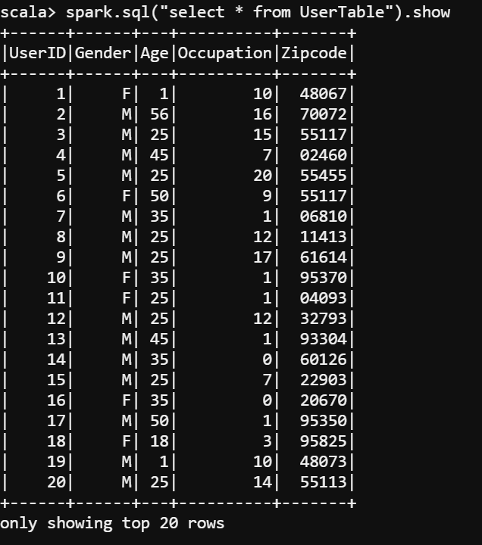
For users.dat:
case class usersClass(UserID:Int, Gender:String, Age:Int, Occupation:Int, Zipcode:String)
val usersVar = usersRDD.map(_.split("::"))
.map(row=>usersClass(row(0).trim.toInt,
row(1).trim,
row(2).trim.toInt,
row(3).trim.toInt,
row(4))).toDF()
usersVar.createOrReplaceTempView("UserTable")

Slide 10
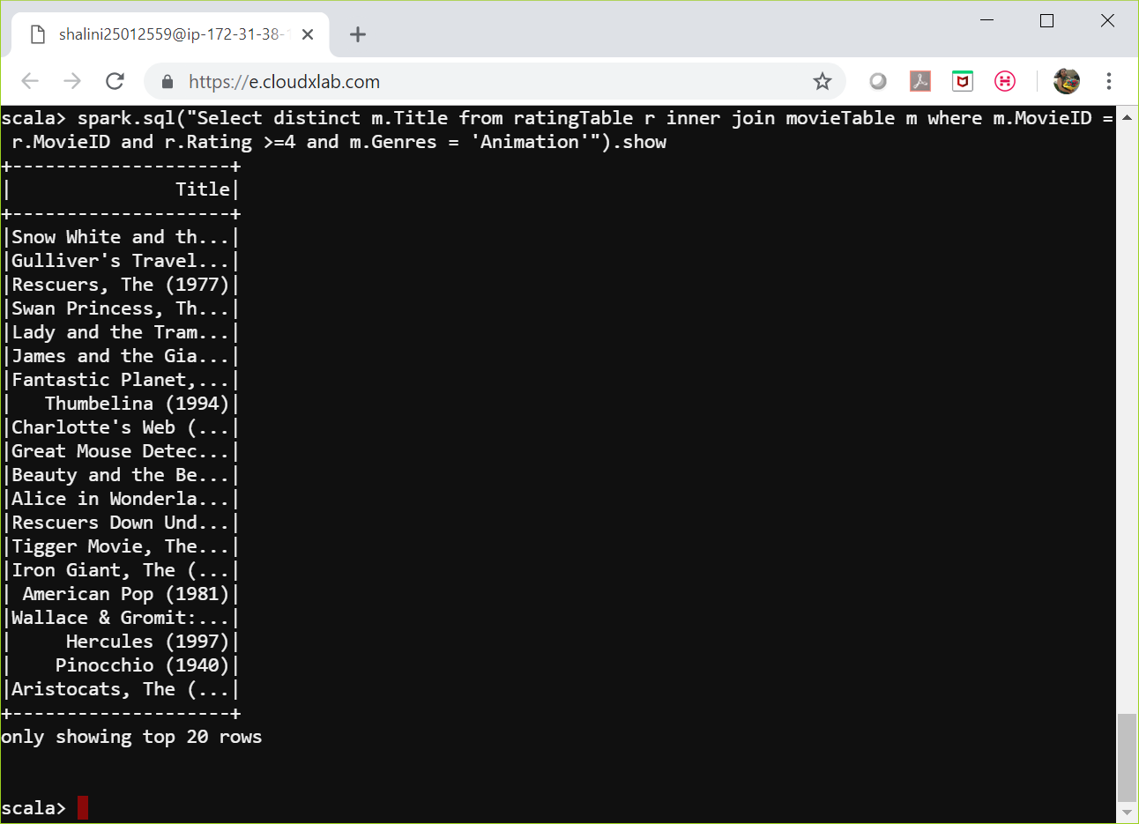
Q1. Animated Movies that are rated 4 or above
spark.sql("Select distinct m.Title from ratingTable r inner join movieTable m where m.MovieID = r.MovieID and r.Rating >=4 and m.Genres = 'Animation'").show

Slide 11
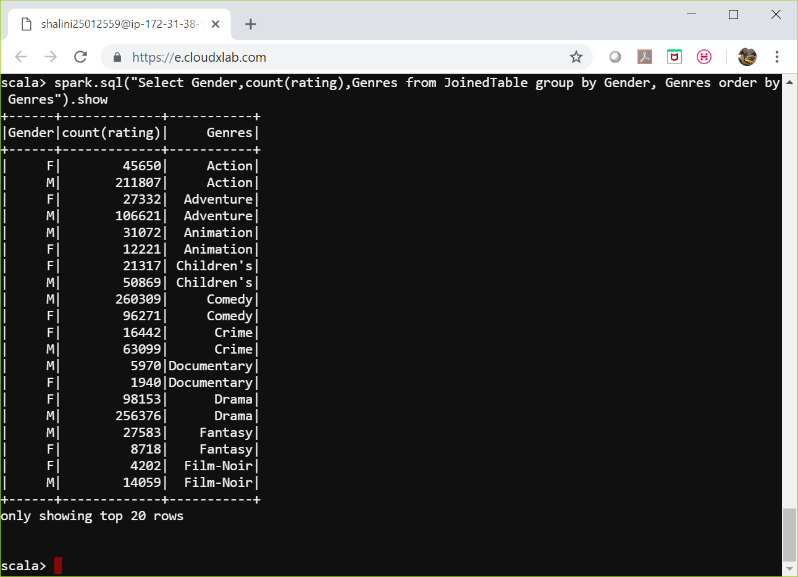
Q2. Detect the gender bias on movie ratings for a genre
val mergedDF = spark.sql("select * from movieTable m inner join ratingTable r inner join UserTable u where m.MovieID = r.MovieID and r.UserID = u.UserID")
mergedDF.createOrReplaceTempView("JoinedTable")
spark.sql("Select Gender,count(rating),Genres from JoinedTable group by Gender, Genres order by Genres").show

Slide 12
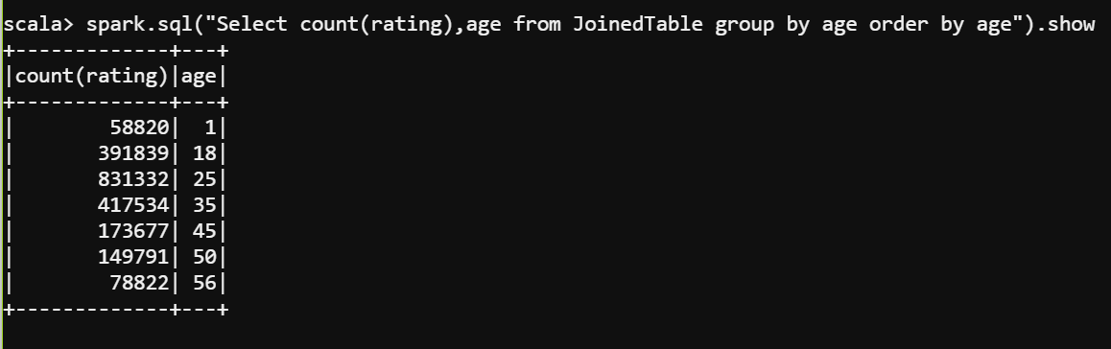
Q3. Group the rating by age
val mergedDF = spark.sql("select * from movieTable m inner join ratingTable r inner join UserTable u where m.MovieID = r.MovieID and r.UserID = u.UserID")
mergedDF.createOrReplaceTempView("JoinedTable")
spark.sql("Select count(rating),age from JoinedTable group by age order by age").show

Slide 13
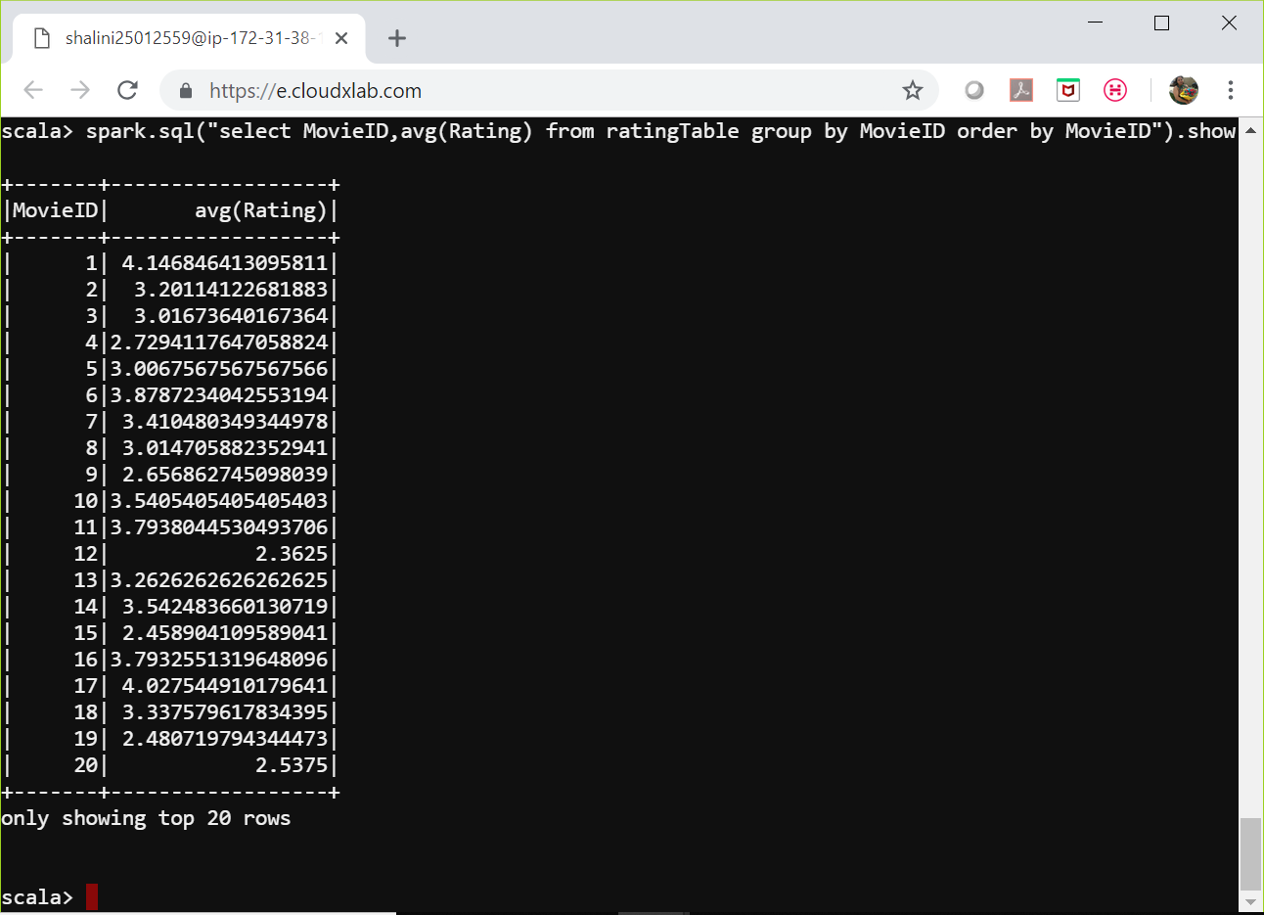
Q4. Find out the average rating for movies
spark.sql("select MovieID,avg(Rating) from ratingTable group by MovieID order by MovieID").show

Slide 14
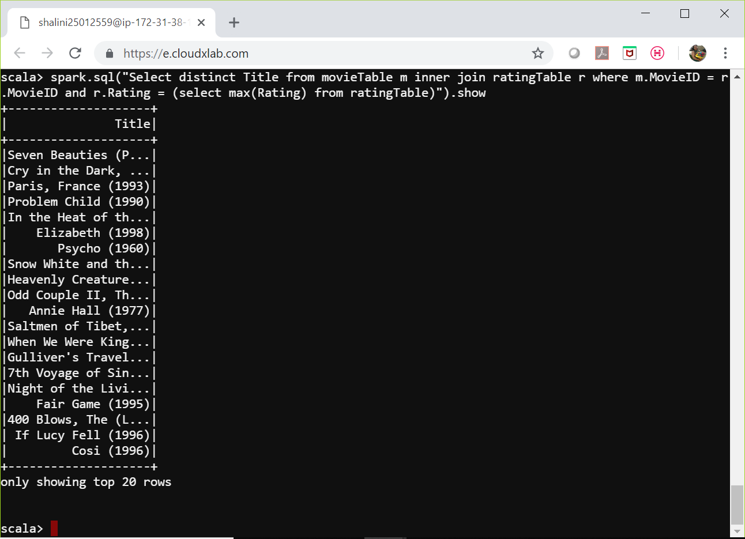
Q5. Find out the titles of the best rated movies
spark.sql("Select distinct Title from movieTable m inner join ratingTable r where m.MovieID = r.MovieID and r.Rating = (select max(Rating) from ratingTable)").show

Slide 15
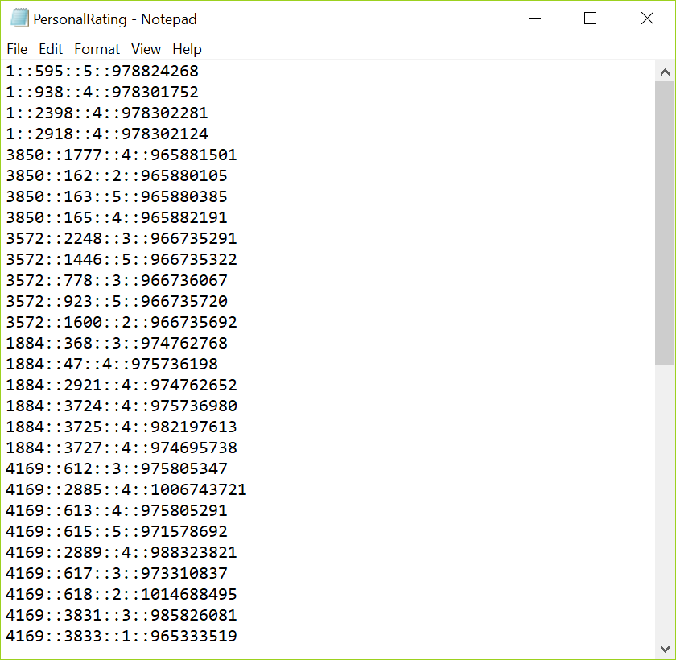
Spark MLLIB Add personal ratings to the movies and train a model to provide movie recommendation based on the personal ratings
PersonalRating.txt is created from ratings.dat. Taken some records from rating.dat
File data:

Slide 16
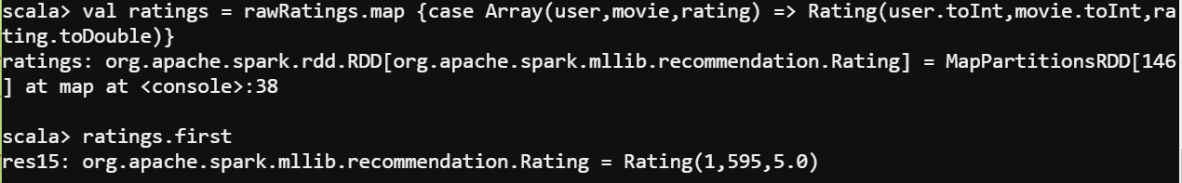
Packages imported:
Data Frame created from PersonalRating.txt:
import org.apache.spark.mllib.recommendation.ALS
import org.apache.spark.mllib.recommendation.Rating
import org.apache.spark.SparkConf
import org.apache.spark.SparkContext
import org.apache.spark.SparkContext._
import org.apache.spark.rdd._
import org.apache.spark.mllib.recommendation.Rating
import org.apache.spark.mllib.recommendation.{ALS,MatrixFactorizationModel, Rating}
val rawData = sc.textFile("PersonalRating.txt")
val rawRatings = rawData.map(_.split("::").take(3))
val ratings = rawRatings.map {case Array(user,movie,rating) => Rating(user.toInt,movie.toInt,rating.toDouble)}

Slide 17
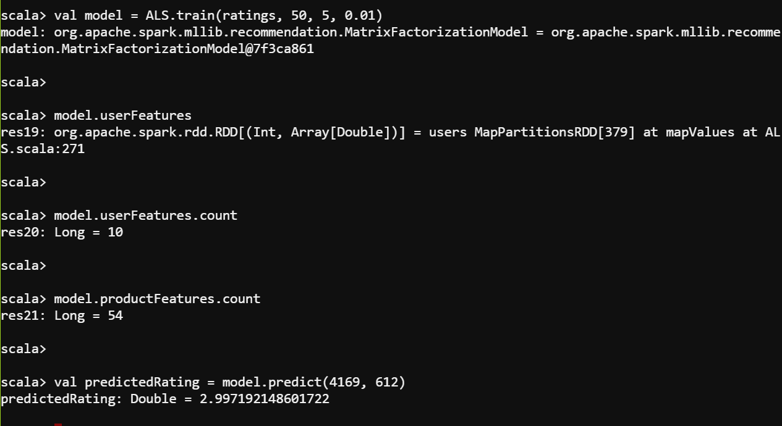
Training the model:
val model = ALS.train(ratings, 50, 5, 0.01)
model.userFeatures
model.userFeatures.count
model.productFeatures.count
val predictedRating = model.predict(4169, 612)

Slide 18
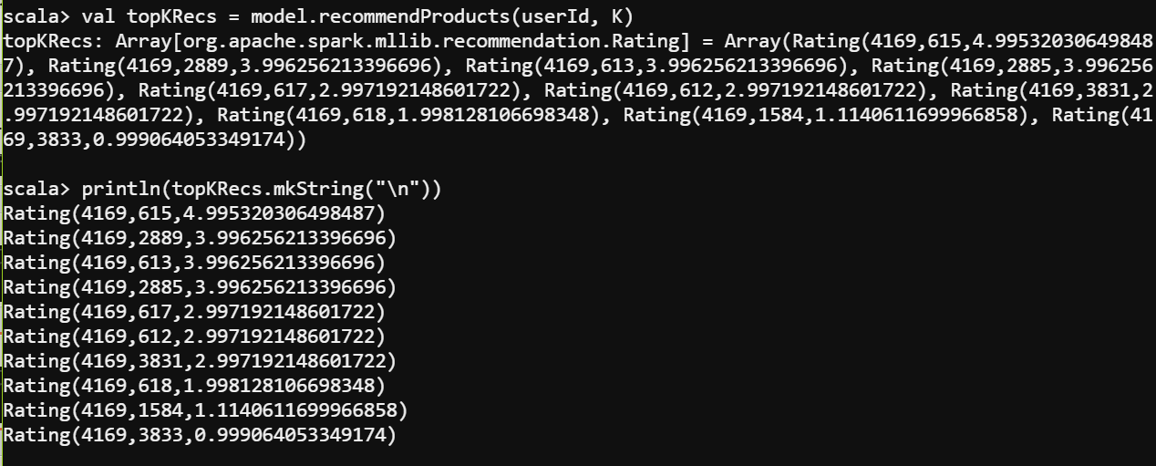
Selecting top 10 movies for user ID 4169:
val userId = 4169
val K = 10
val topKRecs = model.recommendProducts(userId, K)
println(topKRecs.mkString("\n"))

Slide 19
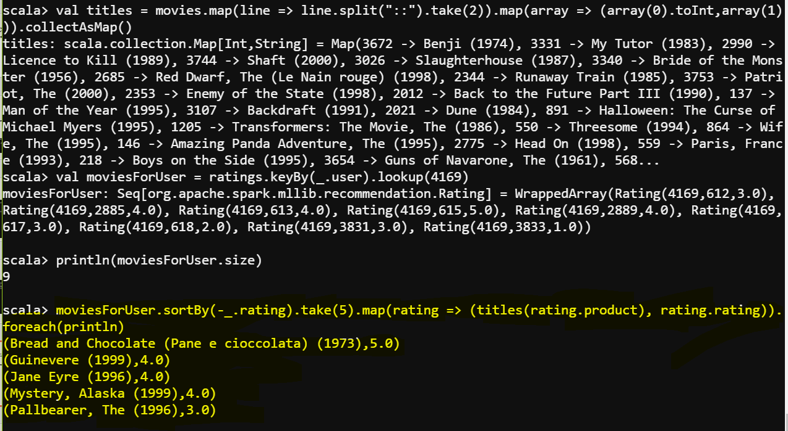
Printing titles of top 5 recommended movies for user 4169:
val movies = sc.textFile("movies.dat")
val titles = movies.map(line => line.split("::").take(2))
.map(array => (array(0).toInt,array(1))).collectAsMap()
val moviesForUser = ratings.keyBy(_.user).lookup(4169)
println(moviesForUser.size)
moviesForUser.sortBy(-_.rating).take(5)
.map(rating => (titles(rating.product), rating.rating)).foreach(println)

Slide 20
Thank you!!

